Slide 1

Multi-Class Cancer Classification Using Gene Expression and Machine Learning
22BIO211- Intelligence of Biological Systems - 2
TEAM 10
CH.SC.U4AIE23008 – CH.Mohith Reddy
CH.SC.U4AIE23009 – CH.Nayanesh Reddy
CH.SC.U4AIE23033 – M.Likhith Reddy
CH.SC.U4AIE23035 – N.Harshith Varma
CH.SC.U4AIE23038 – N.Charan
CH.SC.U4AIE23040 – P.M.D.Kalesha

Slide 2
Problem Statement
Cancer remains one of the leading causes of death worldwide, and early and accurate classification of cancer types is crucial for effective treatment and prognosis. Traditional diagnostic methods often struggle with handling high-dimensional gene expression data, leading to challenges in precision and efficiency. This study aims to leverage machine learning techniques to classify different cancer types based on gene expression data. By evaluating eight machine learning models—Gradient Boosting, Logistic Regression, Naïve Bayes, Linear Discriminant Analysis (LDA), Random Forest, Support Vector Machine (SVM), K-Nearest Neighbors (KNN), and Multi-Layer Perceptron (MLP)—this research seeks to identify the most effective model for accurate cancer classification. The study also addresses challenges such as feature selection, class imbalance, and data preprocessing to enhance model performance and reliability.

Slide 3
Agenda
Introduction
Cancer is a major global health concern and one of the leading causes of death, making early and accurate classification crucial for effective treatment. Gene expression analysis, enabled by DNA microarrays and RNA sequencing, provides valuable insights into identifying cancer types. However, challenges such as high-dimensional data, class imbalance, and computational complexity must be addressed to improve classification accuracy.
Machine learning (ML) has proven to be an effective approach for cancer classification, with models like Support Vector Machine (SVM) and Random Forest demonstrating high performance. This study evaluates eight ML models—Gradient Boosting, Logistic Regression, Naïve Bayes, Linear Discriminant Analysis (LDA), Random Forest, SVM, K-Nearest Neighbors (KNN), and Multi-Layer Perceptron (MLP)—to classify cancer types based on gene expression data. Advanced techniques such as SelectKBest for feature selection and SMOTE for class balancing are applied to optimize performance. The research aims to enhance the accuracy and reliability of cancer classification through data-driven computational methods.

Slide 4
OBJECTIVES:
Develop an Efficient Cancer Classification Model – Implement and compare multiple machine learning
models to classify cancer types using gene expression data.
Enhance Model Accuracy and Reliability – Optimize feature selection, hyperparameters, and data
preprocessing techniques to improve classification accuracy and generalization.
Address High-Dimensionality Challenges – Utilize feature selection techniques like SelectKBest to
reduce dimensionality while retaining the most relevant genetic markers.
Handle Class Imbalance – Apply Synthetic Minority Over-sampling Technique (SMOTE) to balance the
dataset and improve classification performance.
Evaluate Model Performance – Assess models based on accuracy, precision, recall, F1-score, and
confusion matrices to determine the best-performing approach.
Contribute to Precision Oncology – Provide insights into how machine learning can support cancer
diagnosis and assist in personalized treatment strategies.

Slide 5
Machine Learning Models Used in the Research
1.Logistic Regression (LR)
A statistical model for binary and multi-class classification.
Uses a logistic function to estimate probabilities.
Works well for linearly separable data.
2.Naïve Bayes (NB)
Based on Bayes' theorem with an assumption of feature independence.
Efficient for high-dimensional data like gene expression.
Performs well with small datasets and probabilistic predictions.
3.Linear Discriminant Analysis (LDA)
Projects data into a lower-dimensional space for classification.
Maximizes class separability by minimizing intra-class variance.
Works best when class distributions are nearly Gaussian.

Slide 6
Machine Learning Models Used in the Research
4.Random Forest (RF)
An ensemble of multiple decision trees for robust classification.
Reduces overfitting by averaging multiple tree predictions.
Handles high-dimensional data and missing values effectively.
5.Support Vector Machine (SVM)
Identifies the optimal hyperplane for separating classes.
Effective for high-dimensional and complex datasets.
Uses kernel functions to map non-linear data into a higher dimension
6.K-Nearest Neighbors (KNN)
Classifies data points based on the majority class of k nearest neighbors.
Simple and effective, especially for well-separated classes.
Sensitive to feature scaling and the choice of k value.

Slide 7
Machine Learning Models Used in the Research
7.Multi-Layer Perceptron (MLP)
A type of artificial neural network with multiple layers.
Uses activation functions like ReLU and sigmoid for non-linearity.
Effective for capturing complex patterns in data.
8.Gradient Boosting (GB)
A boosting technique that builds decision trees sequentially.
Each tree corrects the errors of the previous one.
Provides high accuracy and is useful for structured data classification.

Slide 8
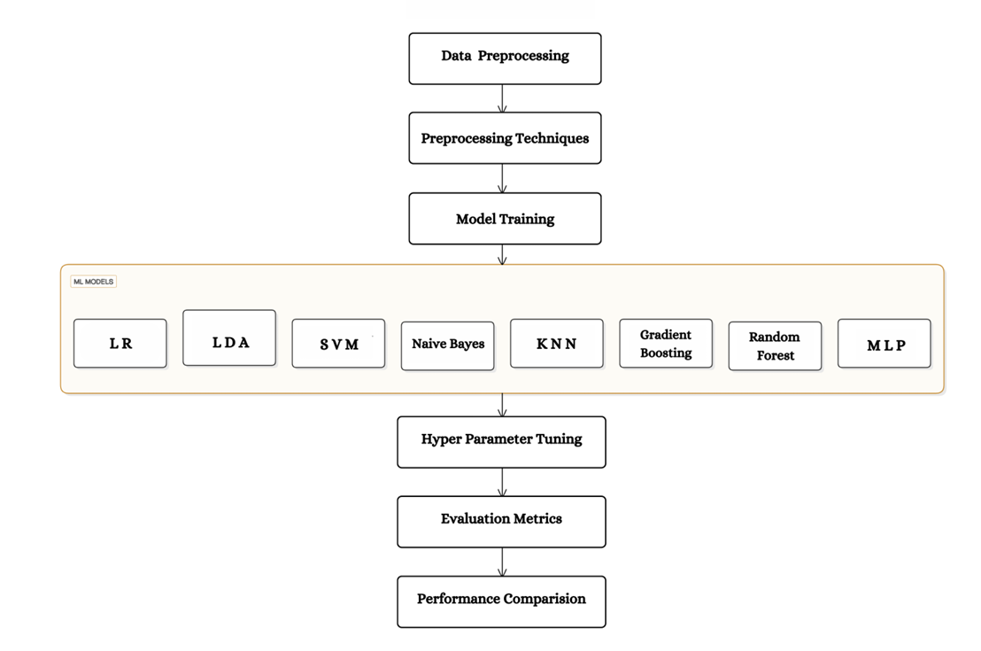
Architecture Diagram:

Slide 9
METHODOLOGY:
1. Data Collection
The dataset used is 11tumors2, which contains 174 samples with 12,534 gene expression features.
Each sample has a corresponding class label representing the cancer type.
The data was primarily generated through microarray analyses to study gene expression variations across tumor types.
2. Data Preprocessing
Since gene expression data is high-dimensional and imbalanced, several preprocessing techniques were applied:
a) Feature Selection
SelectKBest was used to choose the most important features for each model
The value of k was adjusted individually for different models to maximize performance.

Slide 10
METHODOLOGY:
b) Scaling
Different scaling techniques were applied based on the model's requirements:
StandardScaler – Used for Logistic Regression, LDA, SVM, KNN, and MLP.
MinMaxScaler – Used for Naïve Bayes (since it requires non-negative values).
RobustScaler – Used for Gradient Boosting and Random Forest to handle outliers.
c) Data Balancing
Synthetic Minority Over-sampling Technique (SMOTE) was applied to handle class imbalance.
This technique generates synthetic samples for minority classes, preventing biased model predictions.
3. Model Selection and Training
Eight machine learning models were selected and trained:
Logistic Regression (LR)
Naïve Bayes (NB)
Linear Discriminant Analysis (LDA)
Random Forest (RF)

Slide 11
METHODOLOGY:
Support Vector Machine (SVM)
K-Nearest Neighbors (KNN)
Multi-Layer Perceptron (MLP)
Gradient Boosting (GB)
Each model was trained using a stratified K-fold cross-validation approach to ensure robustness and prevent overfitting.
4. Evaluation Metrics
The trained models were evaluated using key classification metrics:
Accuracy – Measures overall correctness of predictions.
Precision – Evaluates how many predicted positives were actually correct.
Recall (Sensitivity) – Assesses the model’s ability to detect actual positives.
F1-score – A harmonic mean of precision and recall for balanced evaluation.
Confusion Matrices – Visual representations of model predictions vs. actual classes.

Slide 12
Agenda
Literature Review
S.NO | Title | Author Journal Year | Methodology/Algorithms/Architecture used | Merits | Demerits | Research gap
1. | Gene Selection Based Cancer Classification With Adaptive Optimization Using Deep Learning Architecture | Anju Das , N.Neelima , K.Deepa , Tolga Ozer doi: 10.1109/ACCESS.2024.3392633 | Cross-reference selected genes with biological databases (e.g., KEGG or GO) to ensure relevance to cancer pathways. Incorporate attention mechanisms for gene interactions and relevance weighting. Use metrics such as accuracy, precision, recall, F1-score, and AUC-ROC to assess model performance. Use techniques such as t-tests, ANOVA, or chi-squared tests to identify genes significantly associated with cancer types. | The combination of gene selection and deep learning ensures that only the most relevant features are used, leading to higher classification accuracy. Adaptive optimization techniques enhance the model's performance by dynamically fine-tuning parameters. The use of feature selection and dimensionality reduction techniques addresses the high dimensionality of gene expression data, reducing computational costs and overfitting risks. | Data Availability: Gene expression datasets for specific cancer types may be limited, affecting the generalizability of the model. Data Imbalance: Imbalanced datasets with unequal representation of cancer types can lead to biased classification results. Preprocessing Challenges: Handling noise, batch effects, and normalization inconsistencies in gene expression data can be complex and time-consuming. . | Current gene selection methods often focus on individual gene significance, potentially overlooking synergistic interactions among genes. Many cancer datasets are limited in size, contain imbalances, or lack diversity across populations. Gene expression data alone may not capture the full spectrum of cancer biology.

Slide 13
S.NO | Title | Author Journal Year | Methodology/Algorithms/Architecture used | Merits | Demerits | Research gap
2. | Clinical and prognostic significance of FBXL6 expression in ovarian cancer | Dianxin Tao a,1 , Shenghan Lou a,1 , Wei Huang a , Kaidi Sun a , Jian Li b , Zhiqiang Wang a , Yanan Pi a , Yue Zhao a , Jinglin Wen a , Qin Xie a , Fanling Meng a,* , Ge Lou a Doi:https://doi.org/10.1016/j.gene.2024.148978 | Ovarian cancer is the fifth most deadly cancer for women globally. Most cases are diagnosed at an advanced stage because there are no good screening methods. Standard treatment is surgery and platinum-based chemotherapy, but most patients die within 5 years because the cancer comes back or resists treatment. Finding new biomarkers could help with earlier diagnosis and better treatment decisions. | FBXL6 as a Biomarker: The study suggests that FBXL6 could be a new biomarker for predicting the outcome of ovarian cancer. Prognostic Nomogram: A nomogram incorporating FBXL6 expression, age, and FIGO stage was developed and showed strong predictive accuracy for patient survival. Potential Therapeutic Target: FBXL6's role in regulating key cellular pathways suggests potential new treatment targets for ovarian cancer. | Limited Sample Size: The study involved a relatively small patient group, potentially limiting the generalizability of the findings. Retrospective Design: The study's retrospective nature introduces potential biases due to limitations in data collection and control of confounding factors. Focus on Overall Survival: The study primarily examined overall survival, with limited investigation of other clinically important outcomes like progression-free survival or response to treatment. | Limited functional validation of FBXL6's role in ovarian cancer: The study primarily focused on the association between FBXL6 expression and clinical outcomes. Further research is needed to: Investigate the specific molecular mechanisms by which FBXL6 contributes to ovarian cancer progression. Determine the direct functional impact of FBXL6 on ovarian cancer cell growth, proliferation, survival, and metastasis through in vitro and in vivo experiments. .

Slide 14
S.NO | Title | Author Journal Year | Methodology/Algorithms/Architecture used | Merits | Demerits | Research gap
3. | The Human Pathology Atlas for deciphering the prognostic features of human cancers | Meng Yuan , Cheng Zhang , Kalle Von Feilitzen , Martin Zwahle, Mengnan Shi , Xiangyu Li , Hong Yang , Xiya Song , Hasan Turkez , Mathias Uhlén ,Adil Mardinoglu DOI: https://doi.org/10.1016/j.ebiom.2024.105495 | Tissue Samples: Collect tissue samples from human cancer patients. Gene Expression Profiling: Use RNA-sequencing, microarray analysis, or proteomics to measure gene and protein expression levels in cancer tissues. Histopathology Imaging: Include high-resolution histological images of cancer tissues using techniques like H&E staining. Clinical Data: Incorporate patient data, including demographics, treatment history, and survival outcomes. | Combines transcriptomics, proteomics, and immunohistochemical data for robust analysis. Integrates large-scale datasets such as those from TCGA (The Cancer Genome Atlas) and other population-wide studies. Identifies gene expression patterns and protein markers linked to survival outcomes.Helps in discovering novel prognostic biomarkers for different cancer types. | Inadequate Coverage: Some rare cancers or subtypes may not be well-represented in the data. Overfitting to Certain Biomarkers: Prognostic markers identified in one cohort may not generalize across diverse patient populations due to biological and environmental variability. Retrospective Nature of Data: Much of the analysis relies on retrospective data, which may not always predict future outcomes accurately. | The Atlas focuses primarily on common cancers, leaving rare cancers and pediatric cancers underexplored. The Atlas provides a static snapshot of gene and protein expression without accounting for how these profiles change over time. Many biomarkers are identified through computational methods but lack experimental or clinical validation.

Slide 15
S.NO | Title | Author Journal Year | Methodology/Algorithms/Architecture used | Merits | Demerits | Research gap
4. | Applying the Deep Learning Techniques to Solve Classification Tasks Using Gene Expression Data | SERGII BABICHEV , IGOR LIAKH, AND IRINA KALININA DOI: 10.1109/ACCESS.2024.3368070 | Split the data into training, validation, and test sets. A typical split might be 70% training, 15% validation, and 15% testing. Ensure that each split maintains the same distribution of target classes (e.g., disease vs. healthy) to avoid biased training. While deep learning models are effective at learning hierarchical representations, incorporating domain knowledge about genes can improve performance. | Deep learning models can handle large-scale datasets with thousands of genes. Traditional methods struggle with the high-dimensional nature of gene expression data, but deep learning can learn complex relationships and patterns in such high-dimensional spaces. Deep learning can automatically learn relevant features from the raw gene expression data, reducing the need for manual feature extraction or selection. | Deep learning models, especially deep neural networks, are computationally expensive to train. This requires significant hardware resources, such as high-performance GPUs or TPUs, and can lead to high operational costs. Gene expression datasets may come from different experimental conditions, labs, or technologies, which can introduce biases. | Gene expression data is often noisy, and dealing with class imbalances is a challenge. More robust preprocessing techniques are needed to handle these issues without introducing bias. Research into more advanced denoising algorithms, or developing new techniques to address class imbalance in deep learning models, could significantly improve model performance.

Slide 16
S.NO | Title | Author Journal Year | Methodology/Algorithms/Architecture used | Merits | Demerits | Research gap
5. | Artificial Intelligence Analysis and Reverse Engineering of Molecular Subtypes of Diffuse Large B-Cell Lymphoma Using Gene Expression Data | SERGII BABICHEV , IGOR LIAKH, AND IRINA KALININA DOI: 10.1109/ACCESS.2024.3368070 | Split the data into training, validation, and test sets. A typical split might be 70% training, 15% validation, and 15% testing. Ensure that each split maintains the same distribution of target classes (e.g., disease vs. healthy) to avoid biased training. While deep learning models are effective at learning hierarchical representations, incorporating domain knowledge about genes can improve performance. | Deep learning models can handle large-scale datasets with thousands of genes. Traditional methods struggle with the high-dimensional nature of gene expression data, but deep learning can learn complex relationships and patterns in such high-dimensional spaces. Deep learning can automatically learn relevant features from the raw gene expression data, reducing the need for manual feature extraction or selection. | Deep learning models, especially deep neural networks, are computationally expensive to train. This requires significant hardware resources, such as high-performance GPUs or TPUs, and can lead to high operational costs. Gene expression datasets may come from different experimental conditions, labs, or technologies, which can introduce biases. | Gene expression data is often noisy, and dealing with class imbalances is a challenge. More robust preprocessing techniques are needed to handle these issues without introducing bias. Research into more advanced denoising algorithms, or developing new techniques to address class imbalance in deep learning models, could significantly improve model performance.

Slide 17
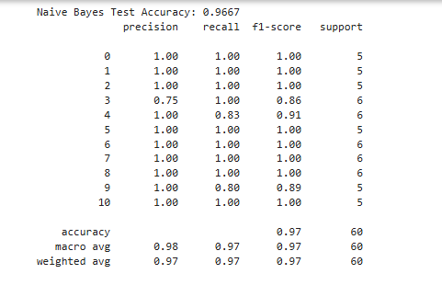
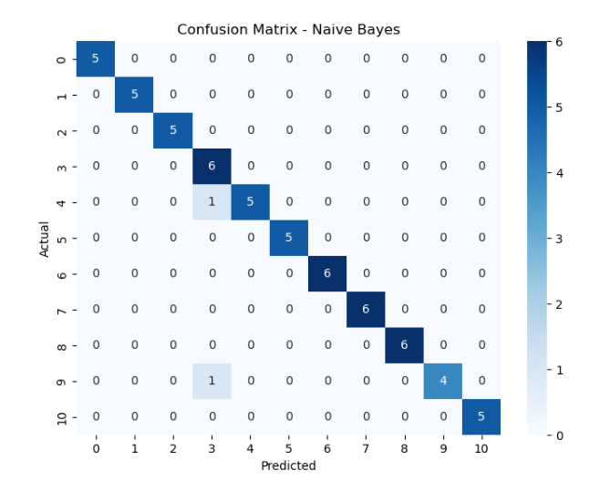
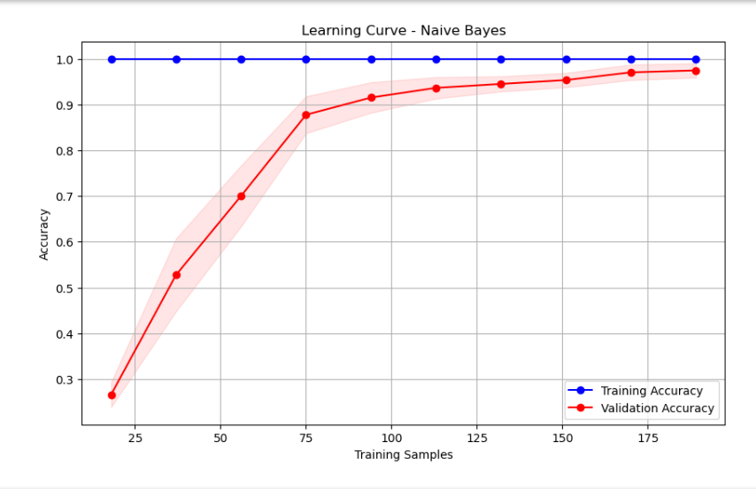
Results:
Naive Bayes(NB) :

Slide 18
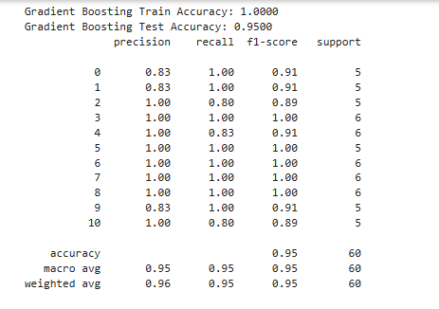
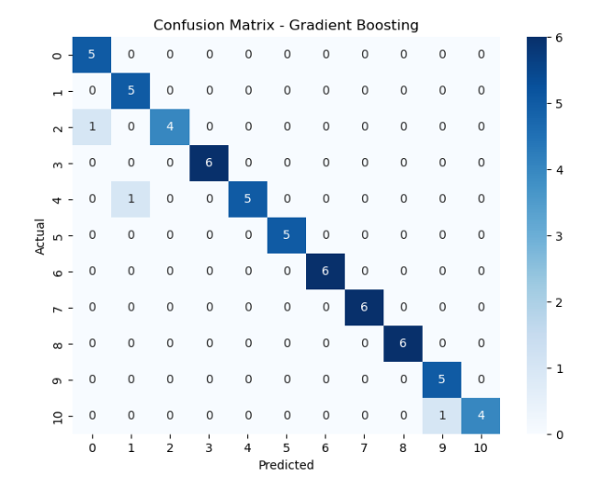
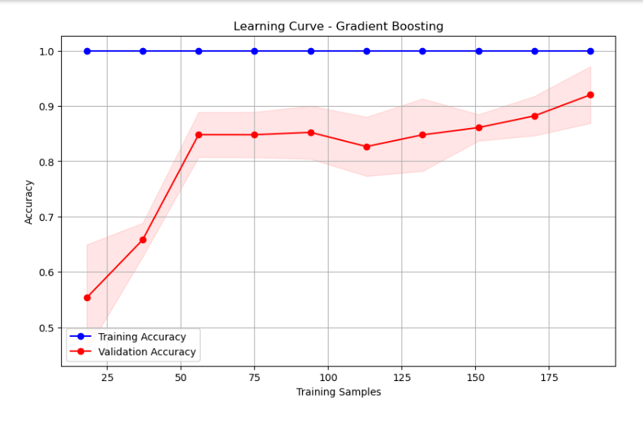
Results:
Gradient Boosting(GB) :

Slide 19
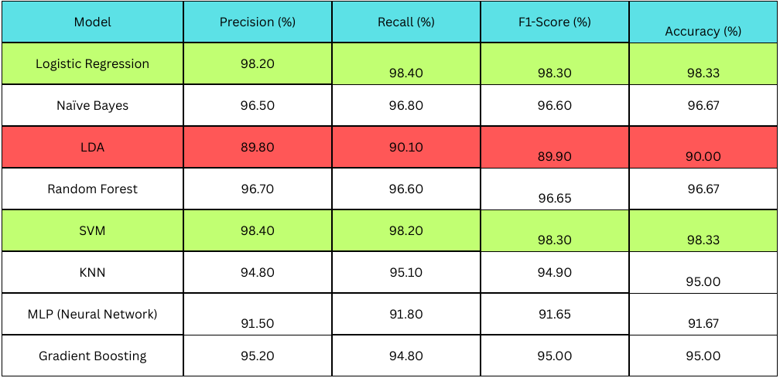
Models Comparison Table:

Slide 20
Conclusion
This research evaluates the performance of eight machine learning models for multi-class cancer classification using gene expression data. The study addresses challenges such as high-dimensional data, class imbalance, and feature selection by applying techniques like SelectKBest for feature selection, SMOTE for data balancing, and appropriate scaling methods for each model.
The results show that Logistic Regression and Support Vector Machine (SVM) achieved the highest accuracy of 98.33%, followed by Naïve Bayes and Random Forest (96.67%) and Gradient Boosting and K-Nearest Neighbors (KNN) (95%). Multi-Layer Perceptron (MLP) performed moderately with 91.67% accuracy, while Linear Discriminant Analysis (LDA) had the lowest performance at 90% accuracy.
This study demonstrates the effectiveness of machine learning in cancer classification and highlights the potential of computational models in assisting early diagnosis. Future work can focus on integrating deep learning techniques like CNNs and RNNs, using larger datasets, and exploring hybrid models for improved accuracy and generalization.

Slide 21
THANK YOU

